Slide 1
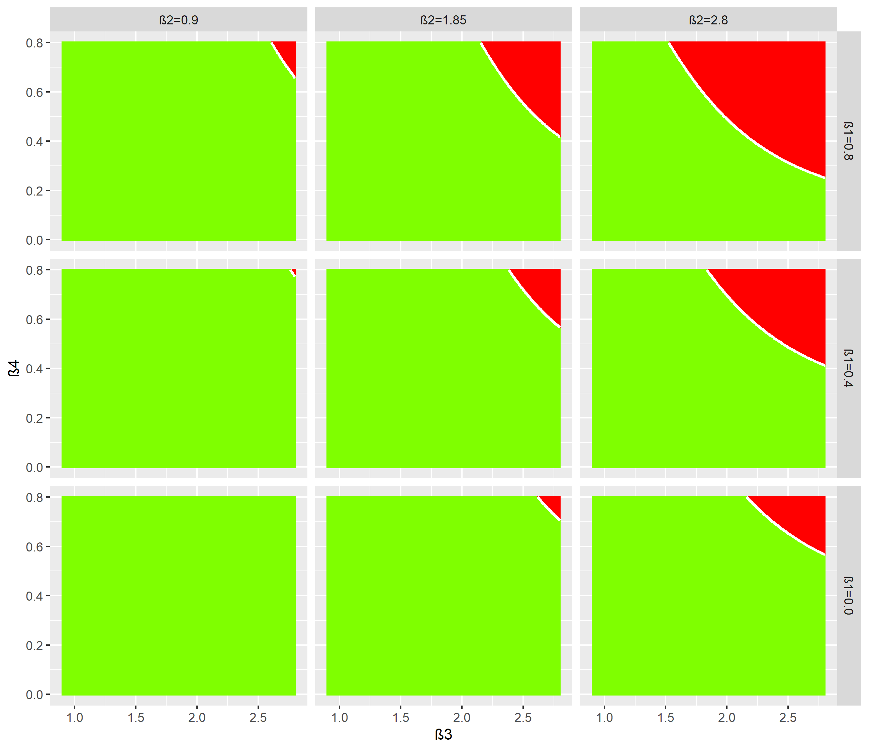
Second peak Iv lower?

Slide 2
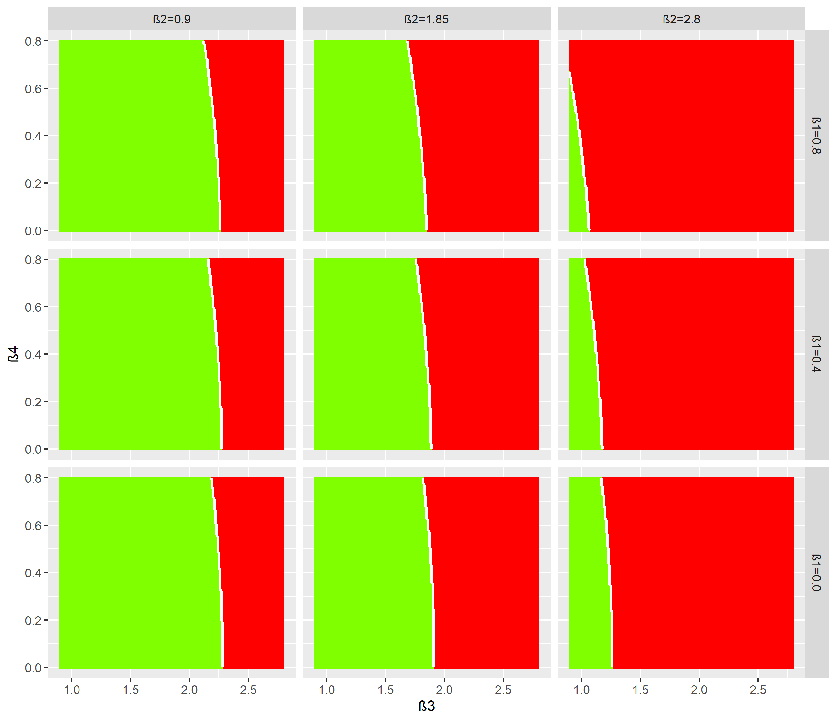
All peaks lower?

Slide 3
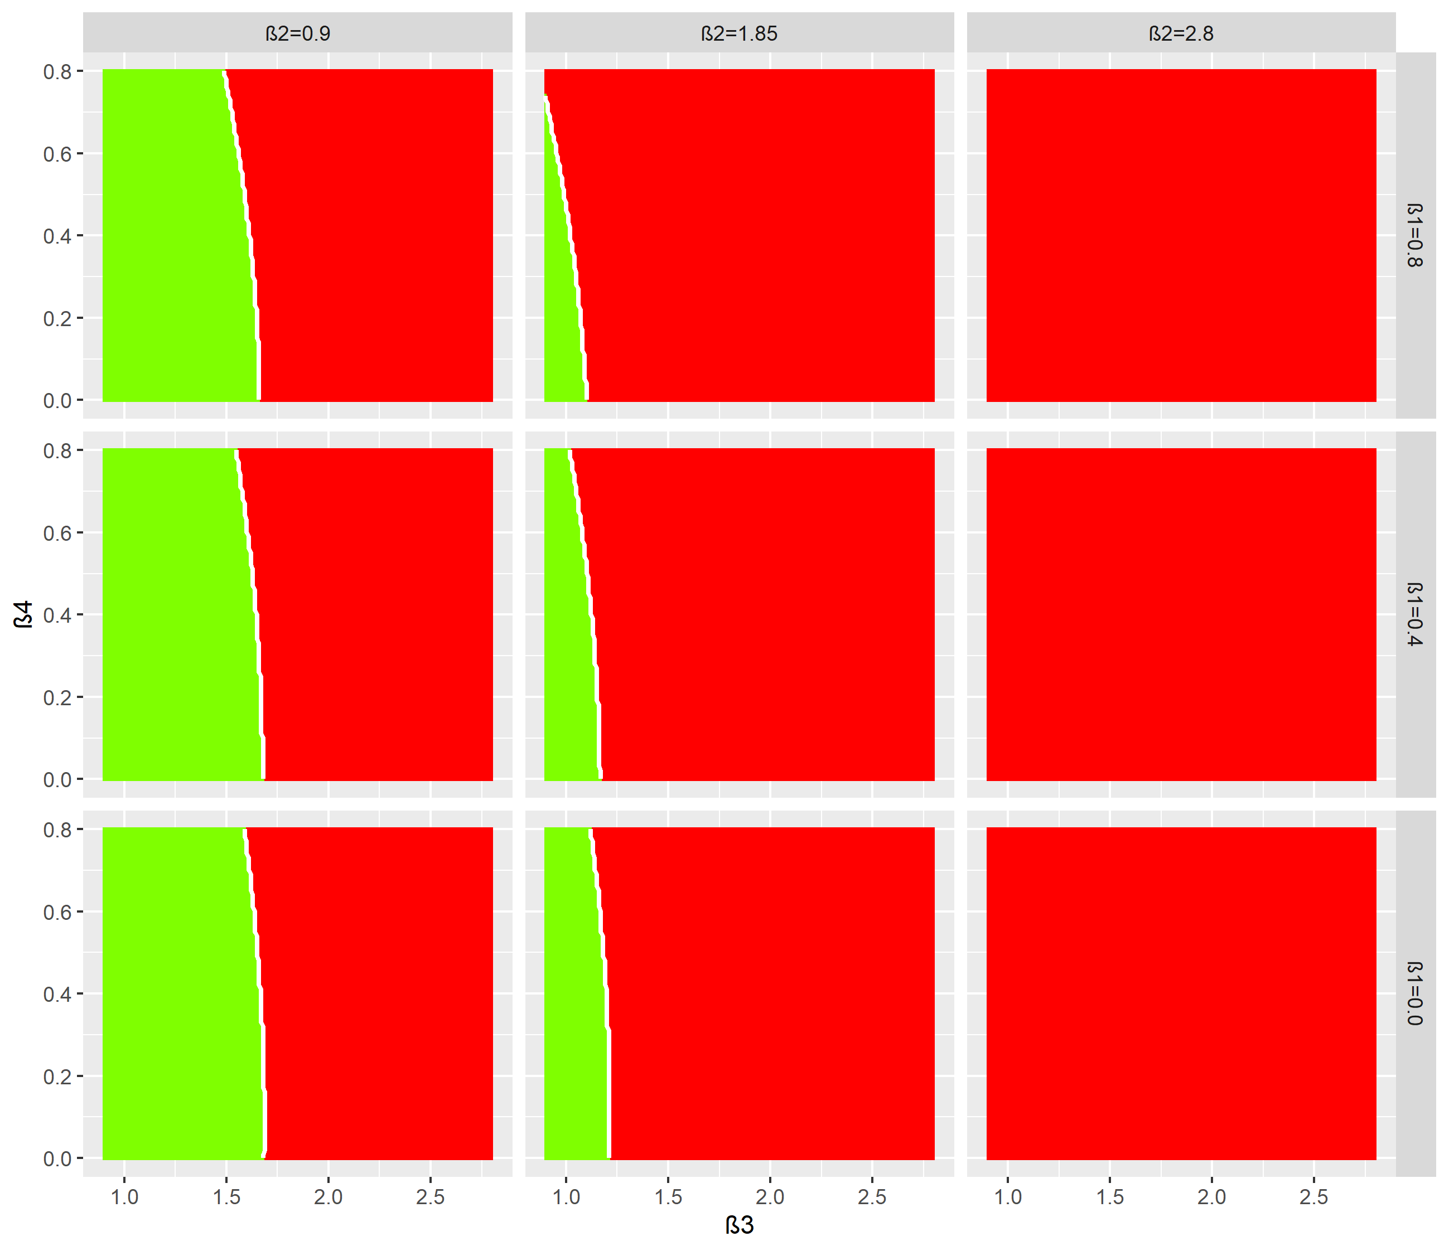
No increase in any of Iv,Ih or Ir

Slide 4
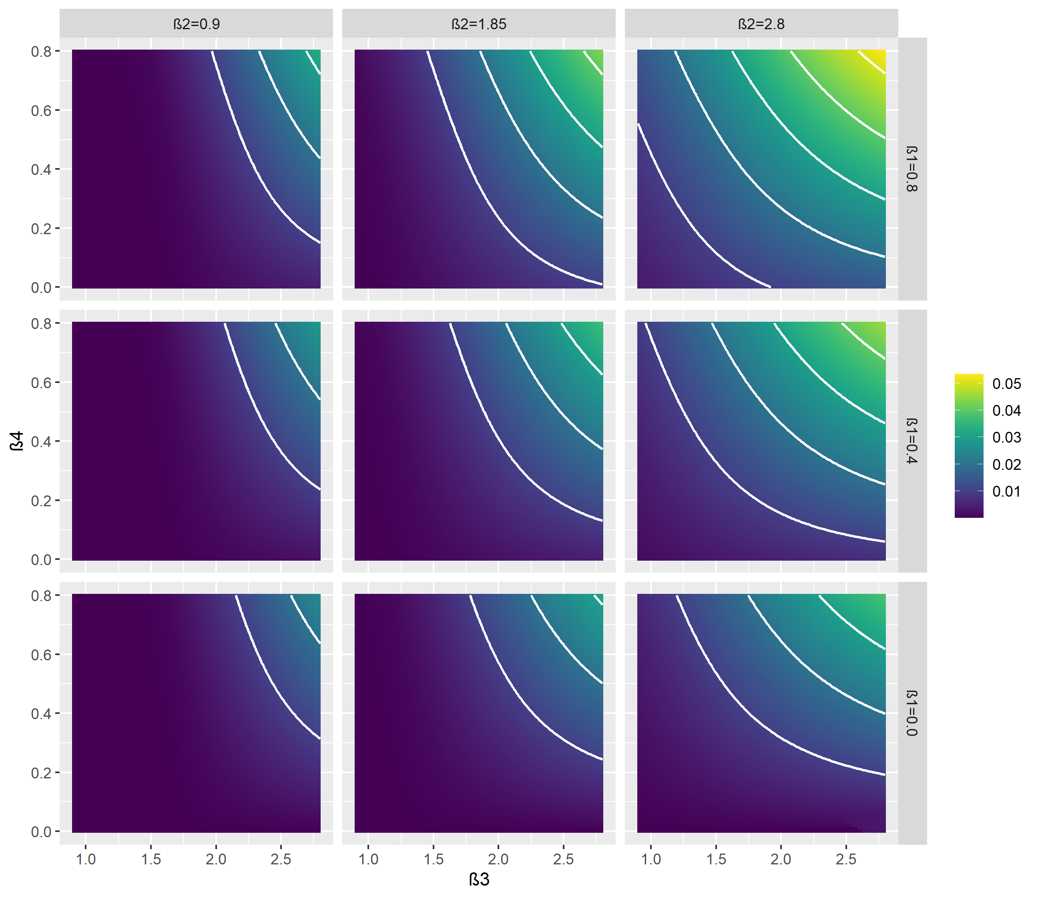
Height second peak

Slide 5
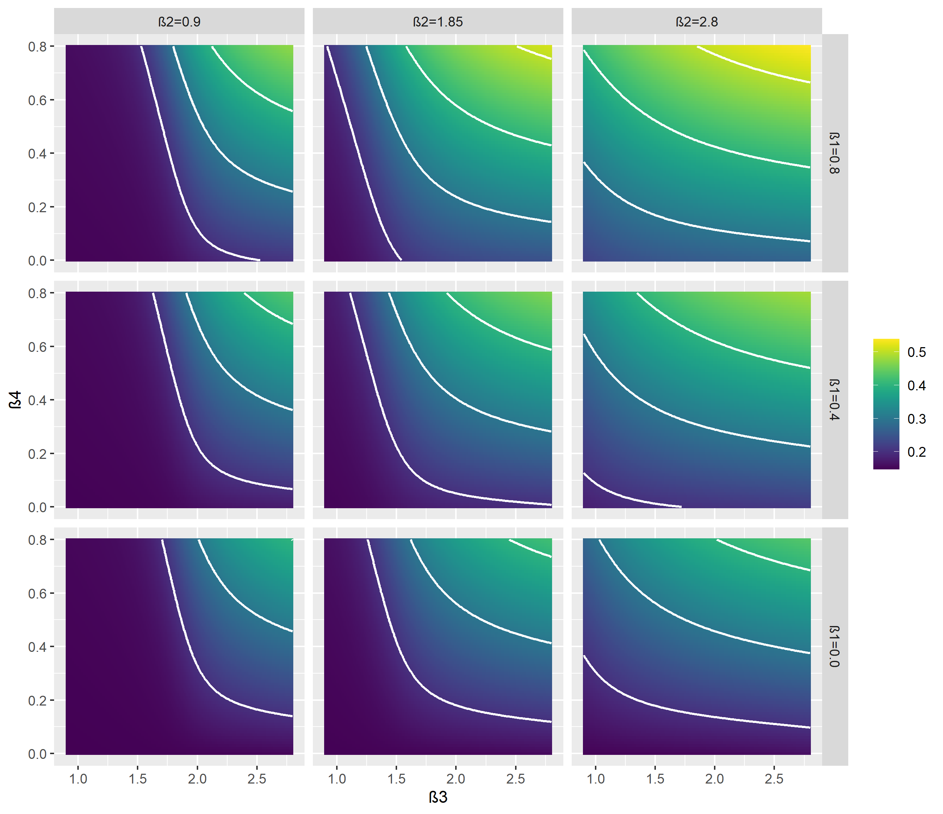
Cumulative Iv 1year after lockdown

Slide 6
A
B
C
D

